Slide 1


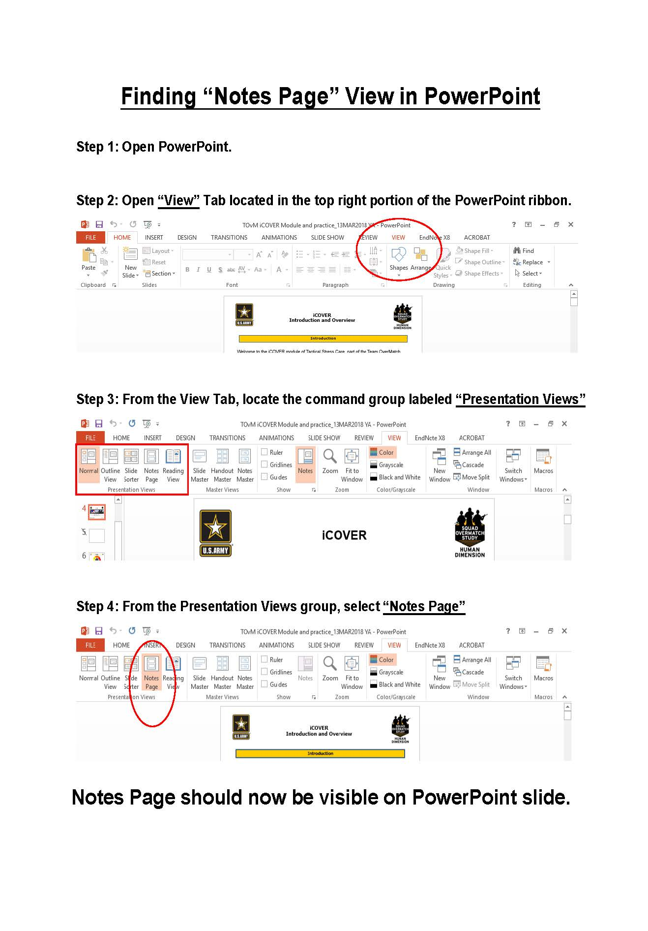
Facilitator Guide: Trainer notes
Notes:
INSTRUCTOR GUIDE
Ask, Care, Escort
Annual Unit Suicide Prevention Training
Lethal Means Safety Module
ACE Base +1
July 2024
VERSION 1.1

Slide 2
(Hidden)
Notes:
i-A

Slide 3
(Hidden)
Notes:
i-B
Introduction
ACE Unit Training- Lethal Means Safety Module
The Army Suicide Prevention Program was instituted by CSA General John A. Wickham in 1984. Since that time, suicide prevention and awareness training have evolved. In 2009, Ask, Care, Escort (ACE) training was introduced to update existing suicide prevention training and to respond to a rise in suicide rates.
ACE training introduced suicide prevention and intervention concepts that had proven successful outside of the Army. Its primary goals were to increase suicide awareness and improve the ability of Soldiers to identify team members who may be suicidal and get them to help.
In 2018, ACE training was updated to highlight its use not only during a crisis, but also before one occurs by incorporating Army team building and unit cohesion concepts. This training is aligned with the Center for Disease Control and Prevention's strategic comprehensive public health approach to suicide prevention.
In 2022, the ACE suicide prevention and intervention material was updated again and coined ACE Base + 1. The training now consists of a base module along with a menu of “+1” modules that the unit’s command team can choose from based upon the unit’s needs. Together, the base module and a +1 module make up the mandatory one hour of annual suicide prevention and intervention training.
In addition to the tailored training approach, the training is now designed to be more interactive and conversational. In contrast to a traditional “annual briefing,” ACE Base +1 is an “annual conversation” at platoon level where Soldiers in the platoon are able to discuss how they can take care of one another on a human level as it pertains to suicide prevention and intervention.
In 2023, the Army’s suicide prevention and intervention training expanded to include a tailored curriculum for the Soldiers’ Circle of Support members and DA Civilians. A Soldier’s Circle of Support includes anyone who the Soldier considers to be a priority within their support system, such as a spouse, significant other, parent, sibling, other family member, mentor, and friend. The intent is that offering Circle of Support members the same knowledge and skills while using the same language and strategies can enable conversation between the Circle of Support member(s) and the Soldier regarding suicide prevention and intervention. What’s more, it can promote effective communication, bolster protective factors like increased cohesion and connection, and increase suicide prevention efforts within the whole Army Family.

Slide 4
(Hidden)
Notes:
ii-A
ACE Unit Training- Lethal Means Safety Module
Facilitated discussion and engagement: This training is designed to be facilitated by a single instructor and delivered in an interactive, discussion-based format (rather than conventional lecture or didactic format). Because this module utilizes group interaction, it is recommended that it be led by an instructor who is able and willing to elicit participant engagement through facilitating meaningful discussions and practical exercises. The practical exercises are essential in allowing participants the opportunity to try out the Ask, Care, Escort process strategies in a safe, non-threatening environment and develop competence and confidence to use the strategies in real-life scenarios.
Delivered in-person to small groups: The ACE training is intended to be delivered in-person and it is recommended that this training be conducted with small groups (fewer than 40). In-person training allows for optimal engagement and also fosters unit cohesion, thus building protective factors which is an aim of the training.
Cohesive efforts: It is recommended that the ACE for Circle of Support training be offered around the same time frame that the Soldiers receive the ACE Unit Training. According to AR 600-63, ACE suicide prevention and intervention training must be offered to Circle of Support members on an annual basis. The ACE Base for Circle of Support module resembles the content and format of the ACE Base module for Soldiers but has been tailored for members of a Soldier’s Circle of Support (e.g., spouse, significant other, parent(s), siblings, extended family, friends, mentors).
Intent
Material has been reviewed by the Walter Reed Army Institute of Research. There is no objection to its presentation and/or publication. The opinions or assertions contained herein are the private views of the author, and are not to be construed as official, or as reflecting true views of the Department of the Army or the Department of Defense.

Slide 5
(Hidden)
Notes:
ii-B
The mention of any non-federal entity and/or its products is not to be construed or interpreted, in any manner, as federal endorsement of that non-federal entity or its products.
Note: Each module should be trained to standard and not to time, it is most effective when time is allowed for in-depth group discussion and participation. To maximize the benefits of this training, allow for extra time for dialogue and interaction.
Training Package Components: The complete “ACE Base +1” training package consists of five PowerPoint® presentations (i.e., ACE Base, Fighting Stigma, Active Listening, Practicing ACE, and Lethal Means Safety) and a SmartGuide with key information to be discussed for each slide (see notes page iv for SmartGuide overview).
Training Precautions: The ACE suicide prevention and awareness training deals with sensitive information and may trigger painful memories or other issues for training participants. It is possible that someone attending the training may have experienced thoughts of suicide or may have experienced a loved one who has struggled with suicidal thoughts, ideation, or worse – died by suicide.
If you are not a chaplain or behavioral health provider, it is recommended that you have someone from the chaplain’s office or Behavioral Health Services on call during your training session. Be sure to coordinate before the training and obtain their name, title, and consent to act as an immediate resource if needed. Provide them with the date, time, and location of the training; on the day of the training, be sure to have the number(s) at which they can be reached or another plan for reaching them.
Training Requirements: The U.S. Army’s requirement for annual suicide prevention training is to complete one hour of training that includes the “ACE Base” module along with one of the “+1” modules.
ACE Unit Training- Lethal Means Safety Module

Slide 6
(Hidden)
Notes:
iii-A
Training Preparation:
Content: This is part of the U.S. Army’s mandatory annual suicide prevention training (IAW AR 600-63). The material is based on the most current research and academic literature on suicide prevention and follows educational best practices. The training is designed to enable the instructor to lead participants through suicide prevention concepts with interactive activities and discussions to prompt critical thinking. For the training to be most effective, it is advised that instructors review all content in advance.
When instructing, follow the content as written. Insert personal stories/examples as appropriate. Prompts are written into the SmartGuide to highlight times when personal stories/examples can be most valuable. There are many benefits of sharing a personal story or example. For instance, stories/examples can help a trainer to capture the audience’s attention, gain common ground with the audience, and engage the audience on a deeper level. Most importantly, effective use of personal stories or examples can help participants gain better contextual understanding of the material being taught.
The following guidelines can help ensure effective use of personal stories and examples. The story/example
serves a clear purpose, specifically it reinforces the training objective/content
helps participants to gain a better contextual understanding about the concepts
does not distract participants from the focus of training (e.g., be mindful of using potentially triggering or traumatizing examples/stories)
is simple, concise, and easy to follow/understand
Remember, sharing your personal stories/examples is to benefit the participant, not yourself. The story/example should highlight the content, not you as a person (e.g., avoid the mistake of making the training about yourself). Lastly, it is highly recommended that you practice your stories/examples before using them in a training session. Rehearsing the story/example can improve effective delivery, especially if the story/example is one that could be emotional for you to share.
Flow: This training module is comprised of four main sections.
ACE Unit Training- Lethal Means Safety Module

Slide 7
(Hidden)
Notes:
iii-B
Training Preparation (continued):
Language: Suicide can be an uncomfortable topic to discuss, and it can be challenging to find the words to talk about it. As researchers continue to learn more about suicide and those impacted by it, the language used continues to evolve. For example, the term “committed suicide” perpetuates the idea that suicide is a criminal act, which can be stigmatizing. Instead, consider using the phrases “died by suicide” or “attempted suicide.” Additionally the terms “failed” suicide and “successful” suicide imply that lethal self-harm is an achievement. Instead, use “attempted suicide” or “completed suicide.”
Participants may unintentionally use stigmatizing language, as not everyone understands the harmful impact of these words. It is recommended that during the training, participants are allowed to use the words they feel comfortable with to promote open conversation; however, it is recommended that the instructor supports participant usage of destigmatized language and use those words themselves. Providing gentle correction and guidance to trainees on the use of appropriate language can help foster an Army culture that embraces best practices in discussing suicide.
Important concepts: The following analogy helps to clarify the differences between risk factors and warning signs:
Risk factors do not always indicate an emergency but may suggest that a problem is developing. For example, poor diet, lack of exercise, and family history of heart problems, if left unchecked, increase risk for a heart attack. Similarly, financial distress, relationship issues, and increased isolation, if left unchecked, increase risk for suicide.
Warning signs indicate that there is a need to take immediate action. For example, signs such as tightness in the chest, tingling arm, flushed face, struggling to breathe—warning signs of a heart attack—clearly show need for intervention. Similarly, signs such as talking about death, giving belongings away, talking about harming oneself, or other significant changes in behavior—warning signs of suicide—clearly show need for intervention.
ACE Unit Training- Lethal Means Safety Module

Slide 8
(Hidden)
Notes:
iv-A
ACE Training Facilitation Strategies:
Review the SmartGuide prior to the training session. Take notes on when you may use different facilitation strategies to promote an effective learning experience for participants.
ACE Unit Training- Lethal Means Safety Module

Slide 9
(Hidden)
Notes:
iv-B
ACE Unit Training- Lethal Means Safety Module

Slide 10
(Hidden)
Notes:
v-A
ACE Unit Training-Lethal Means Safety Module

Slide 11
(Hidden)
Notes:
v-B

Slide 12
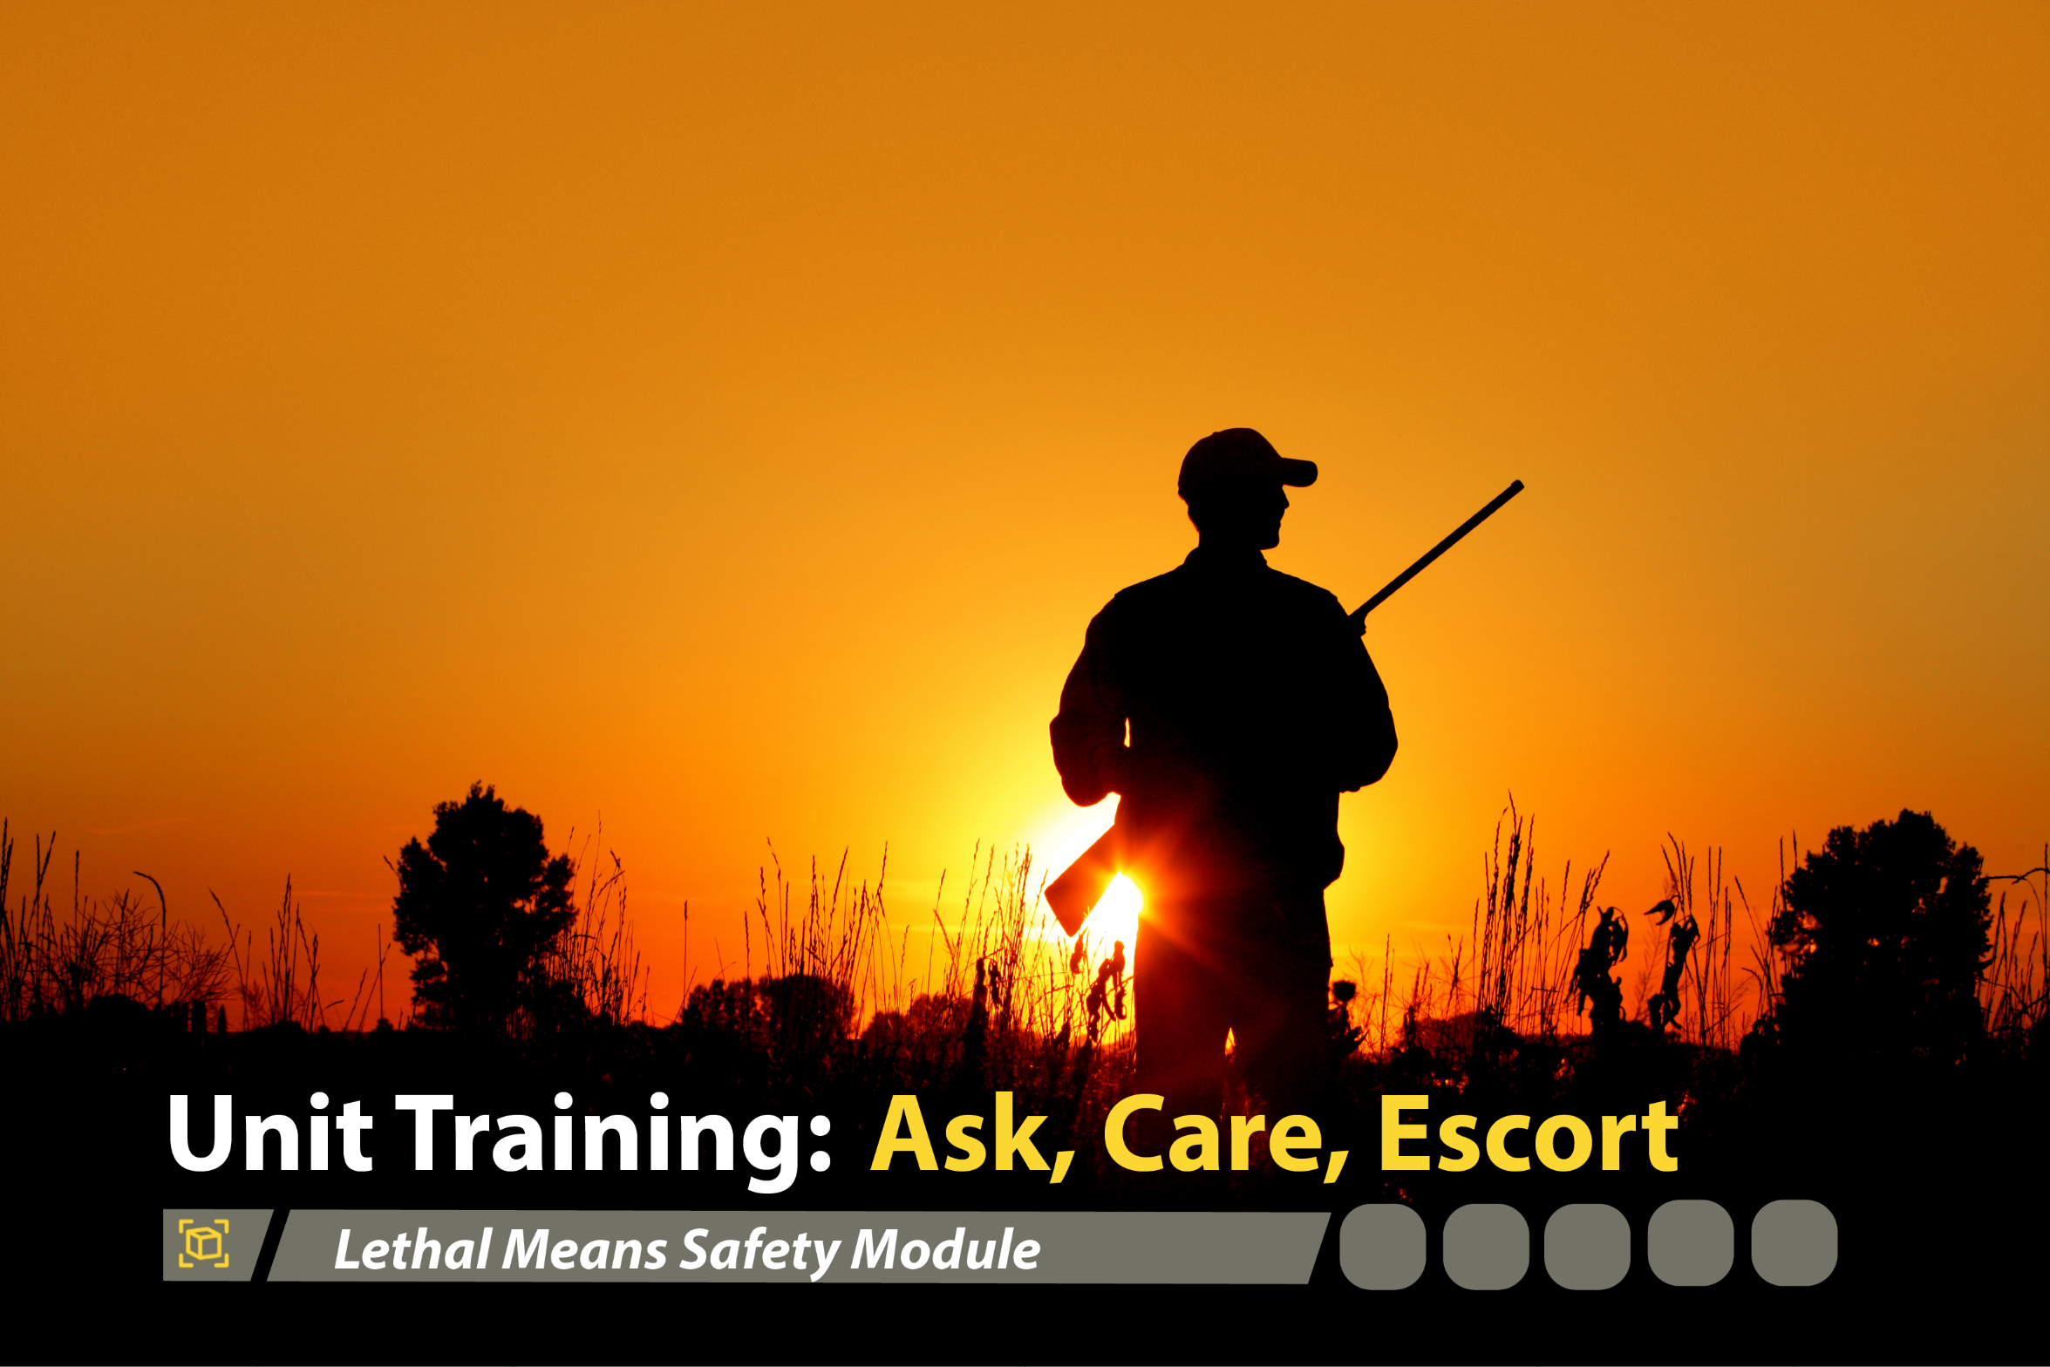



Lethal Means Safety Module
1
Notes:
Record your own notes here:
ACE Unit Training- Lethal Means Safety Module
1-A

Slide 13
(Hidden)
Notes:
1-B

Slide 14


Concrete Experience: The Story of Drew Robinson
Impact of Suicide on the Army
Drew Robinson was once known for being a Major League Baseball (MLB) player of the Texas Rangers and the St. Louis Cardinals. While having achieved his goal of making it to the big leagues, his experience was anything but easy. He had been demoted to the minor leagues several times, and he had injured his left elbow and required surgery. In August of 2019, the Cardinals released him. Despite his continuation with behavioral health therapy, he felt increasingly frustrated with himself and he was worried he was going to end up in the minor leagues again. Little did anyone know that Drew suffered from
depression and suicidal ideation. Drew felt as though he was not good enough for his fiancée and he called off the wedding. After becoming increasingly isolated by the COVID-19 pandemic, he asked himself, “Who would care if I’m gone?” That evening, on April 16, 2020, Drew sat on his living room couch, drinking whiskey, and shot himself in the right temple. Drew Robinson survived.
What risk factors or warning signs can you identify in Drew’s story? If he was one of your friends, what would you do?
2
Notes:
Record your own notes here:
[NOTE: The Drew Robinson story was chosen to be used with the Soldier population for various reasons: (1) as a survivor and as a mental health advocate, Drew is able to share his story in a way that others can empathize and learn from; (2) there is a level of separation for the Soldiers to focus on an athlete rather than a comrade in arms; (3) Soldier examples have potential to distract from the key points (e.g., fixate on nuances) whereas Drew’s story can be reviewed with more objectivity; and (4) Soldiers can continue to learn from Drew and his story via the abundance of stories and videos available (e.g., a one hour documentary on ESPN titled, “E60: Alive - The Drew Robinson Story”)]
2-A
ACE Unit Training- Lethal Means Safety Module
[?]

Slide 15
(Hidden)
Notes:
2-B
ACE Unit Training- Lethal Means Safety Module
Record your own notes here:
[NOTE: This is just a snapshot of Drew’s story used to engage Soldiers to lean into this topic. Participants who are aware of Drew’s story may be tempted to share more details. Be cognizant of time, and be sure to prioritize the discussion questions that come later in the module as the small group discussion on implementing lethal means safety is more the focus of this training than analyzing or discussing the details of one specific case.]

Slide 16

Training Purpose
To enhance Soldiers’ understanding of Lethal Means Safety (LMS)
To provide an opportunity for Soldiers to consider and discuss ways to promote LMS for themselves and others
To help Soldiers prevent suicide in their unit and in their circles of support
3
Notes:
3-A
ACE Unit Training- Lethal Means Safety Module
Record your own notes here:
[NOTE: The Terminal Learning Objective (TLO) is as follows:
Action: Understand how lethal means safety is critical to suicide prevention and intervention efforts.
Condition: In a classroom environment, given training materials.
Standard: Participants will, with 100% accuracy as assessed by the instructor.
Recognize the role of lethal means safety in suicide prevention.
Describe how safely storing lethal means can lengthen the time from suicidal thoughts to suicidal acts.
Consider how using ACE can promote lethal means safety.]

Slide 17
(Hidden)
Notes:
3-B

Slide 18

Lethal Means, Lethality, and Influencing Factors
Lethality: the capacity to cause death or serious harm or damage
Lethal Means: the methods that can be used in a suicide attempt
Influencing factors:
Ease of accessibility and use
Acceptability to the attempter
Inherent deadliness
Ability to abort mid-attempt
Why might the lethality rate be higher for firearms, jumping, or hanging versus drug poisoning or cutting?
4
Notes:
Record your own notes here:
4-A
ACE Unit Training- Lethal Means Safety Module

Slide 19
(Hidden)
Notes:
4-B
ACE Unit Training- Lethal Means Safety Module
Record your own notes here:

Slide 20

Lethal Means Safety in Action
The goal of lethal means safety is to put time and distance between a means of suicide and a person at risk for suicide, thus making immediate access to the means more difficult and ultimately lowering the risk of death by suicide.
Practicing lethal means safety to prevent loss of life.
lock firearms
separate the ammunition from the firearm
use gun locks and breach barriers
take away firing pins
lock pharmaceuticals / medication
use tear-resistant bedsheets
5
Notes:
5-A
ACE Unit Training- Lethal Means Safety Module
Record your own notes here:

Slide 21
(Hidden)
Notes:
5-B
ACE Unit Training- Lethal Means Safety Module
Record your own notes here:

Slide 22
Small Group Discussions
First, form small groups of 3-5 people…
What does LMS look like as a protective factor? How does having a conversation about LMS work as a protective factor?
What does LMS look like for addressing risk factors? How can the knowledge of LMS work to mitigate risk factors?
What does LMS look like when you identify warning signs? How does LMS reduce the risk of suicide when warning signs are present?
1
2
3
6
Notes:
6-A
ACE Unit Training- Lethal Means Safety Module
Record your own notes here:

Slide 23
(Hidden)
Notes:
6-B

Slide 24
Debrief Discussion Questions
What does LMS look like as a protective factor? How does having a conversation about LMS work as a protective factor?
What does LMS look like for addressing risk factors? How can the knowledge of LMS work to mitigate risk factors?
What does LMS look like when you identify warning signs? How does LMS reduce the risk of suicide when warning signs are present?
1
1
2
2
3
3
7
Notes:
7-A
ACE Unit Training- Lethal Means Safety Module
Record your own notes here:
[?]

Slide 25
(Hidden)
Notes:
7-B
ACE Unit Training- Lethal Means Safety Module
Record your own notes here:

Slide 26
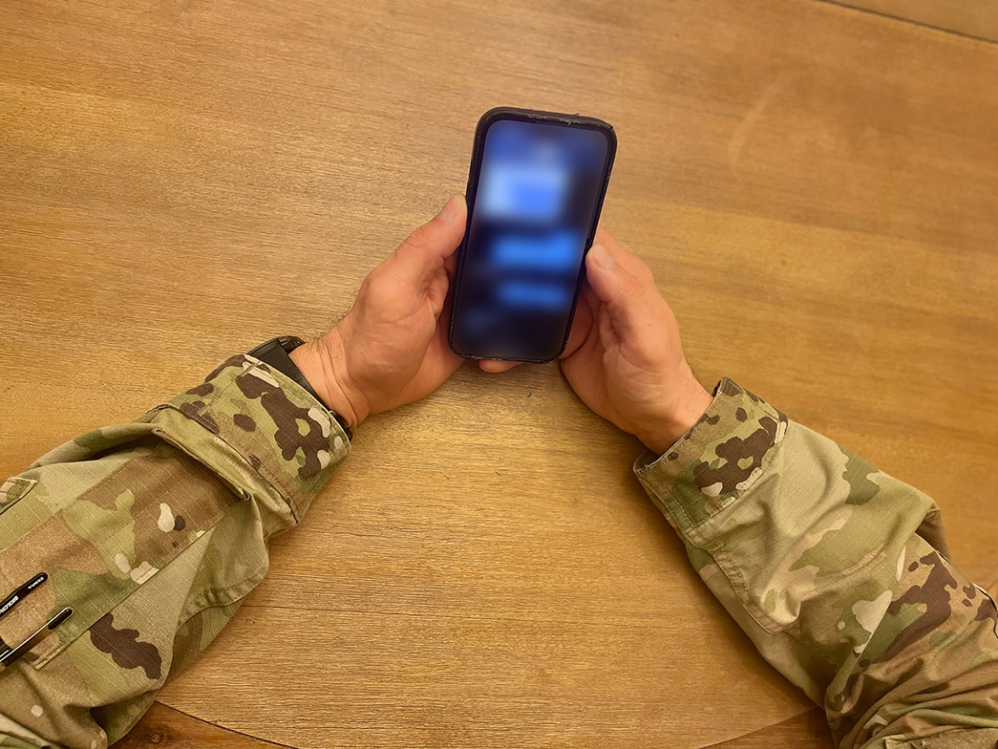
Lethal Means Safety from a Distance
Based on the discussion we just had, what are some ways you can help other Soldiers or Circle of Support members with lethal means safety when you are not physically present?
8
Notes:
8-A
ACE Unit Training- Lethal Means Safety Module
Record your own notes here:

Slide 27
(Hidden)
Notes:
8-B
ACE Unit Training- Lethal Means Safety Module
Record your own notes here:

Slide 28
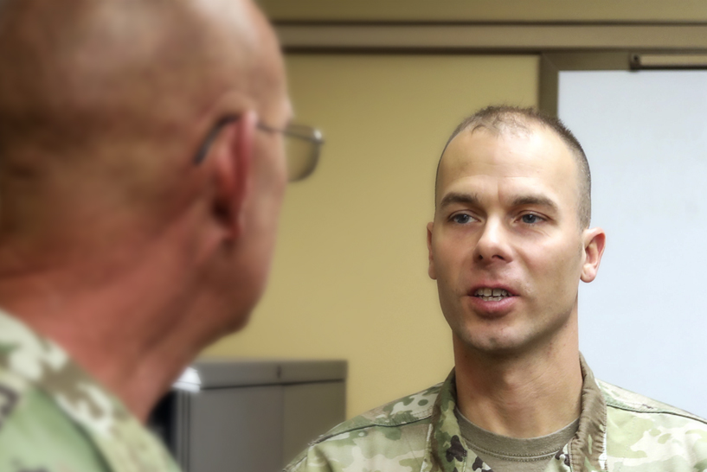
Next Steps: Plan to Implement
What is one thing you plan to do within the next week or two that can help lower the risk of suicide within your unit or among your friends and family members?
Preventing suicide requires taking proactive steps
7
Notes:
9-A
ACE Unit Training- Lethal Means Safety Module
Record your own notes here:
[?]

Slide 29
(Hidden)
Notes:
9-B
ACE Unit Training- Lethal Means Safety Module
Record your own notes here:

Slide 30




Resources
Local Resources
Crisis Hotlines
Your chain of command _____________________
Emergency Room _____________________
Local Emergency Resources
  (Dial 9-1-1)
Military Police _____________________
Civilian Police _____________________
ACE-SI
_____________________
Military/Veterans Crisis Line:
    North America: Dial 988, Press 1
      Text: 838255
    Europe: 00800 1-273-8255 or DSN 118
    Korea: 0808-555-118 or DSN 118
Veterans Crisis Line Online Chat: www.veteranscrisisline.net/chat
Lifeline Crisis Chat: https://988lifeline.org/chat/
National Suicide Prevention Lifeline:
1-800-273-TALK (8255). Press 1
Suicide Hotlines (by State): http://www.suicide.org/suicide-hotlines.html
OCONUS Emergency Services (911)
Germany: Dial 112
Italy: Dial 112,118
South Korea: Dial 119
LMS Resources
Communication Materials: QR code
https://www.armyresilience.army.mil/Lethal-Means/LMS-Home.html
CUI
15
Notes:
Record your own notes here:
[NOTE: Be sure to add contact information for local resources prior to the training.]
15-A
ACE Unit Training- Base Module

Slide 31

Have that Conversation
You know someone who has not secured their lethal means.
Demonstrate care by having that conversation with your friends and loved ones.
Lethal means safety plays an important role in suicide prevention and intervention.
10
Notes:
10-A
ACE Unit Training- Lethal Means Safety Module
Record your own notes here:

Slide 32
(Hidden)
Notes:
10-B

Slide 33
(Hidden)
Notes:
11-A
ACE Unit Training- Lethal Means Safety Module
References
Army Publications
Department of the Army. (2015). Army Health Promotion (AR-300-63). https://armypubs.army.mil/epubs/DR_pubs/DR_a/pdf/web/ARN15595_R600_63_admin_FINAL.p df
Department of the Army. (2019). Army Leadership and the Profession (ADP 6-22). https://armypubs.army.mil/epubs/DR_pubs/DR_a/ARN20039-ADP_6-22-001-WEB-0.pdf
Department of the Army. (2015). Army Team Building (ATP 6-22.6). https://armypubs.army.mil/epubs/DR_pubs/DR_a/pdf/web/atp6_22x6%20FINAL.pdf
Department of the Army. (2016). A Leader’s Guide to Soldier Health and Fitness (ATP 6-22.5). https://armypubs.army.mil/epubs/DR_pubs/DR_a/pdf/web/atp6_22x5.pdf
Department of the Army. (2015). Health Promotion, Risk Reduction, and Suicide Prevention (DA PAM 600-24). https://armypubs.army.mil/epubs/DR_pubs/DR_a/pdf/web/p600_24.pdf
Other Publications
Anestis, M. D., & Bryan, C. J. (2013). Means and capacity for suicidal behavior: a comparison of the ratio of suicide attempts and deaths by suicide in the US military and general population. Journal of affective disorders, 148(1), 42–47. https://doi.org/10.1016/j.jad.2012.11.045
Barber, C. W., & Miller, M. J. (2014). Reducing a suicidal person's access to lethal means of suicide: a research agenda. American journal of preventive medicine, 47(3 Suppl 2), S264–S272. https://doi.org/10.1016/j.ampere.2014.05.028
Bowersox, N. W., Jagusch, J., Garlick, J., Chen, J. I., & Pfeiffer, P. N. (2021). Peer-based interventions targeting suicide prevention: A scoping review. American Journal of Community Psychology, 68(1- 2), 232–248. https://doi.org/10.1002/ajcp.12510
Cerel, J., Brown, M. M., Maple, M., Singleton, M., Van de Venne, J., Moore, M., & Flaherty, C. (2019). How many people are exposed to suicide? Not six. Suicide and Life‐Threatening Behavior, 49(2), 529-534.
Defense Suicide Prevention Office. (2016). Suicide Prevention Training Competency Framework: A competency framework for all members and targeted sub-groups across the Department of Defense. https://www.dspo.mil/Portals/113/Documents/Final%20Signed%20Competency%20
Framework%202016.pdf?ver=2018-02-07-111806-747
Department of Defense. (2022, Oct. 20). Secretary of Defense Lloyd J. Austin III’s Statement on DoD Annual Suicide Report (CY2021). https://www.defense.gov/News/Releases/Release/Article/3193957/secretary-of-defense-lloyd-j-austin-iiis-statement-on-dod-annual-suicide-report/
Department of Defense. (2022). Quarterly Suicide Report (QSR) 4th Quarter, CY 2022. https://www.dspo.mil/Portals/113/Documents/2022QSR/TAB%20A%20-%20QSR%20Rpt_Q4%20CY22_vf.pdf

Slide 34
(Hidden)
Notes:
11-B
References (cont.)
Department of Defense. (2022). Annual Suicide Report Calendar Year 2021. https://www.dspo.mil/Portals/113/Documents/2022%20ASR/Annual%20Report%20on%20Suicide%20in%20the%20Military%20CY%202021%20with%20CY21%20DoDSER%20(1).pdf?ver=tat8FRrUhH2IlndFrCGbsA%3d%3d
Drollinger, T., Comer, L. B., & Warrington, P. T. (2006). Development and validation of the active empathetic listening scale. Psychology & Marketing, 23(2), 161-180. https://doi.org/10.1002/mar.20105
Griffith, J. & Bryan, C. J. (2018). Preventing suicides in the U.S. Military. Psychological Services, 15(3), 251- 261. http://dx.doi.org/10.1037/ser0000225
Hangartner, R. B., Totura, C. M. W., Labouliere, C. D., Gryglewicz, K., & Karver, M. S. (2019). Benchmarking the "Question, Persuade, Refer" Program Against Evaluations of Established Suicide Prevention Gatekeeper Trainings. Suicide & Life-Threatening Behavior, 49(2), 353–370. https://doi.org/10.1111/sltb.12430
Litteken, C., & Sale, E. (2018). Long-Term Effectiveness of the Question, Persuade, Refer (QPR) Suicide Prevention Gatekeeper Training Program: Lessons from Missouri. Community Mental Health Journal, 54(3), 282–292. https://doi.org/10.1007/s10597-017-0158-z
Nock, M. K., Deming, C. A., Fullerton, C. S., Gilman, S. E., Goldenberg, M., Kessler, R. C., McCarroll, J. E., McLaughlin, K. A., Peterson, C., Schoenbaum, M., Stanley, B., & Ursano, R. J. (2013). Suicide among soldiers: a review of psychosocial risk and protective factors. Psychiatry, 76(2), 97–125. https://doi.org/10.1521/psyc.2013.76.2.97
Peterson, A. L., Monahan, M. F., Bender, A. M., Gryglewicz, K., & Karver, M. S. (2021). Don't Invite Everyone! Training Variables Impacting the Effectiveness of QPR Trainings. Administration and Policy in Mental Health, 48(2), 343–353. https://doi.org/10.1007/s10488-020-01078-3
Pietrzak, R. H., Johnson, D. C., Goldstein, M. B., Malley, J. C., Rivers, A. J., Morgan, C. A., & Southwick, S. M. (2010). Psychosocial buffers of traumatic stress, depressive symptoms, and psychosocial difficulties in veterans of Operations Enduring Freedom and Iraqi Freedom: the role of resilience, unit support, and postdeployment social support. Journal of Affective Disorders, 120(1-3), 188–192. https://doi.org/10.1016/j.jad.2009.04.015
Rosa, L. (2014). Reach Out! Suicide prevention using QPR (Question, Persuade, Refer). Louisiana Bar Journal, 62(4), 267. https://www.lsba.org/documents/publications/BarJournal/Journal-Dec14- Jan15.pdf
Rudd, M. D., Berman, A. L., Joiner, T. E., Jr, Nock, M. K., Silverman, M. M., Mandrusiak, M., Van Orden, K., & Witte, T. (2006). Warning signs for suicide: theory, research, and clinical applications. Suicide & Life-Threatening Behavior, 36(3), 255–262. https://doi.org/10.1521/suli.2006.36.3.255
Sarchiapone, M., Mandelli, L., Iosue, M., Andrisano, C., & Roy, A. (2011). Controlling access to suicide means. International journal of environmental research and public health, 8(12), 4550–4562. https://doi.org/10.3390/ijerph8134550
ACE Unit Training- Lethal Means Safety Module

Slide 35
(Hidden)
Notes:
12-A
ACE Unit Training- Lethal Means Safety Module
References (cont.)
Science and Technology Organization. (2018). Military suicide prevention: Report prepared for NATO leadership (Report No. STO-TR-HFM-218). North Atlantic Treaty Organization.
https://apps.dtic.mil/sti/pdfs/AD1062460.pdf
Trachik, B., Tucker, R. P., Ganulin, M. L., Merrill, J. C., LoPresti, M. L., Cabrera, O. A., & Dretsch, M. N. (2020). Leader provided purpose: Military leadership behavior and its association with suicidal ideation. Psychiatry Research, 285, 112722. https://doi.org/10.1016/j.psychres.2019.112722

Slide 36
Notes:
12-B

